Slide 1

Playoff Tournament &
Awards Schedule

Slide 2


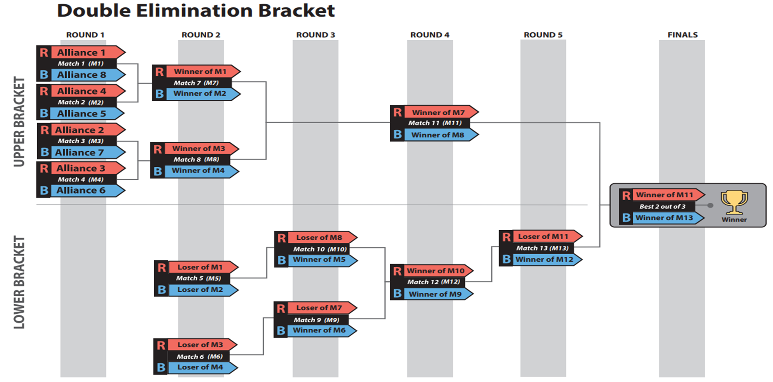

Slide 3
ROUND 1
ROUND 2
Match | Red | Blue
Upper Bracket Round 1 - Match 1 | Alliance 1 | Alliance 8
Upper Bracket Round 1 - Match 2 | Alliance 4 | Alliance 5
Upper Bracket Round 1 - Match 3 | Alliance 2 | Alliance 7
Upper Bracket Round 1 - Match 4 | Alliance 3 | Alliance 6
Match | Red | Blue
Lower Bracket Round 2 - Match 5 | Loser of Match 1 | Loser of Match 2
Lower Bracket Round 2 - Match 6 | Loser of Match 3 | Loser of Match 4
Upper Bracket Round 2 - Match 7 | Winner of Match 1 | Winner of Match 2
Upper Bracket Round 2 - Match 8 | Winner of Match 3 | Winner of Match 4

Slide 4

ROUND 3
ROUND 4
Match | Red | Blue
Lower Bracket Round 3 - Match 9 | Loser of Match 7 | Winner of Match 6
Lower Bracket Round 3 - Match 10 | Loser of Match 8 | Winner of Match 5
6 minute break - videos & music
Match | Red | Blue
Upper Bracket Round 4 - Match 11 | Winner of Match 7 | Winner of Match 8
Lower Bracket Round 4 - Match 12 | Winner of Match 9 | Winner of Match 10
15 minute break - Awards Segment 1 Imagery, Gracious Professionalism, Team Spirit, Rising All Star
Match | Red | Blue
Lower Bracket Round 5 - Match 13 | Loser of Match 11 | Winner of Match 12
15 minute break - Awards Segment 2
Autonomous, Creativity, Quality, Industrial Design

Slide 5
FINALS – best 2 out of 3 matches
Finals- Match 14 | Red | Blue
 | Winner of Match 11 | Winner of Match 13
15 minute break - Awards Segment 3
Innovation in Control, Excellence in Engineering, Team Sustainability, Judges
Finals- Match 15 | Red | Blue
 | Winner of Match 11 | Winner of Match 13
* if Finals are tied 1-1 15 minute break - Awards Segment 4
Rookie All Star, FIRST Leadership, Engineering Inspiration (these awards may be presented at the conclusion of all matches at the discretion of the event organizers)
Finals- Match 16 (if needed) | Red | Blue
 | Winner of Match 11 | Winner of Match 13
Awards Segment 5
Finalist, Winner, FIRST Impact Award

Slide 6



